Slide 1
Directional Dark Matter Search
With Ultra Fine Grain Nuclear Emulsion
Takashi Asada
Flab, Nagoya University
JSPS Research Fellow

Slide 2
Index
Dark Matter
  About dark matter
  Dark matter search experiments
Emulsion R&D
  New production method
  Sensitivity control
Readout R&D
  Optical microscope
  X-ray microscope
Activity
Notes:
emulsion : my field

Slide 3
Index
Dark Matter
  About dark matter
  Dark matter search experiments
Emulsion R&D
  New production method
  Sensitivity control
Readout R&D
  Optical microscope
  X-ray microscope
Activity

Slide 4
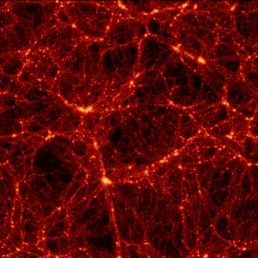
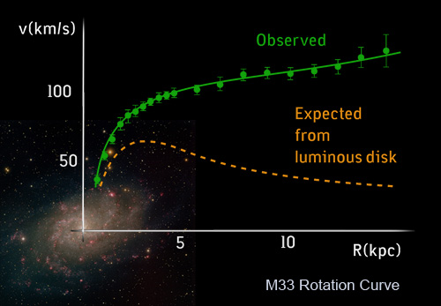
Dark Matter Problem
Planck 2013 results
Dark Energy
68.3%
Ordinary Matter
4.9%
Dark Matter
26.8%
The VIRGO project (N body simulation)
The universe needs the cold dark matter to construct the current structure.
Initial unevenness of dark matter distribution affects CMB
⇒ Dark matter density from WMAP / Plank observation
- Rotation velocity curve of galaxy indicates the existence of dark matter in local scale.

Slide 5
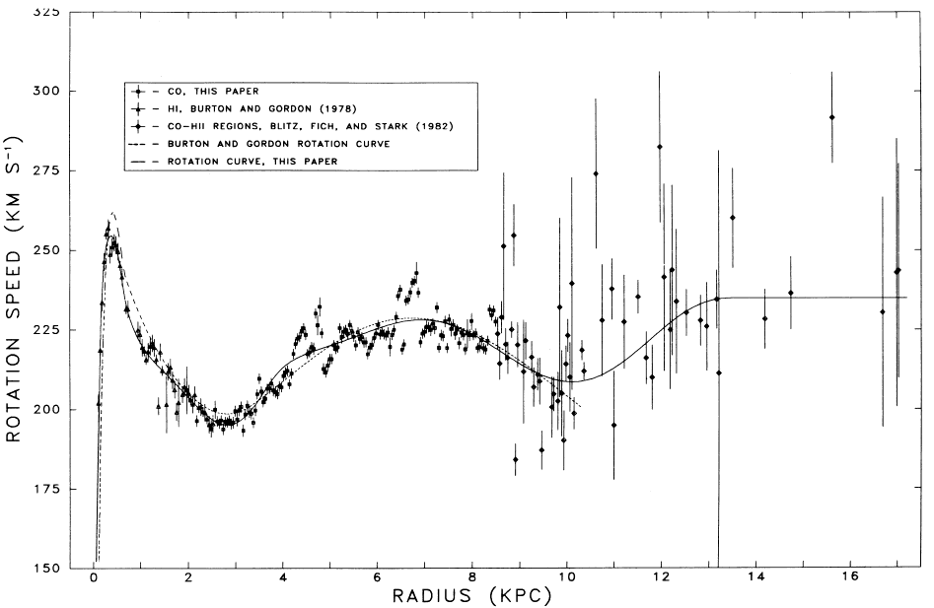
Existence of Dark Matter around Solar System
Rotation Velocity Curve of Milky way Galaxy
Local Dark matter
- density : 0.3-0.5 GeV/cm³
~10000/cm2/sec flux @ earth
(DM mass ~ 100GeV/c²)
velocity distribution
⇒ Maxwellian ??
(astrophysical parameter)
solar system
only visible
Astrophys. J. 295: 422-436, 1985
High accuracy measurement by VERA (2012)
rotation velocity of solar system : 240 +- 14 km/sec
Notes:
Recent experiments show exact velocity of solar systems, and we can calculate Dark matter density near the solar system.
we can assume the dark matter flux because of solar system velocity and dark matter mass.
and that of velocity distribution is limited escape speed and maybe maxwellian.

Slide 6
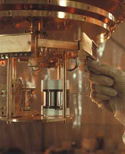
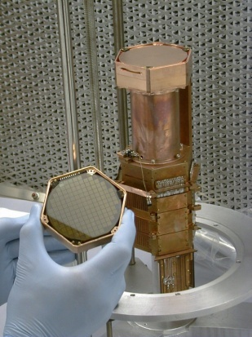
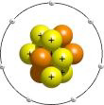
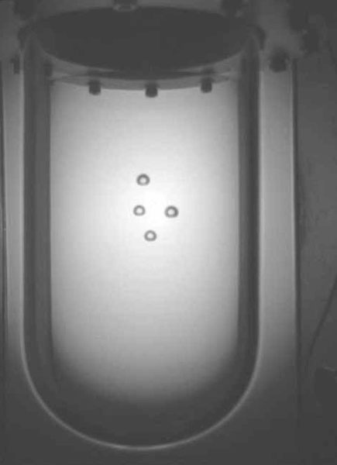
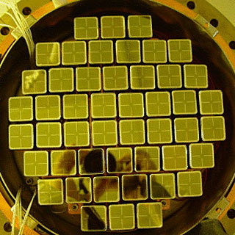
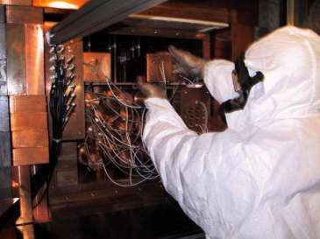
Direct Dark Matter Search
Target : Xe, Ge, Si, NaI, Ar etc
phonon
CRESST
CDMS, EDELWEISS
light
XMASS, DAMA, KIMs
ionization
COUPP
XENON, WArP, ZEPELIN

Slide 7
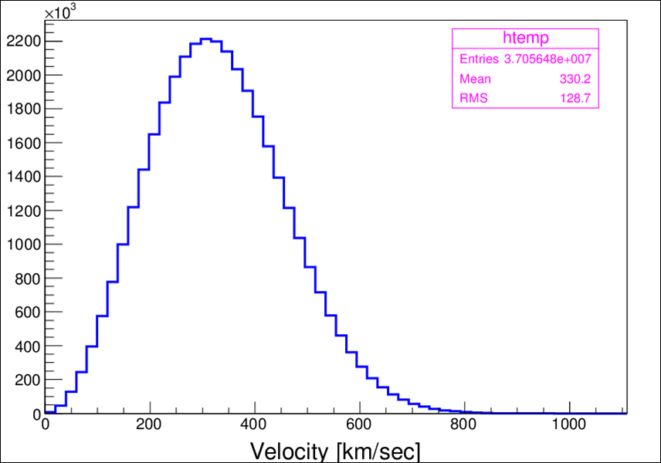
Current Method of Dark Matter Identification
30 km/sec
earth
@summer
@ earth
DM
Direction of solar system
(240km/sec)
Sun
(Example)
Event rate [/kg/kev/day]
few %
30 km/sec
WIMP mass 100GeV
Maxwell velocity distribution
earth@winter
Relative velocity of earth to dark matter is variable by revolution around sun
Annual modulation
Notes:
Their method is this scheme
Solar system recieves WIMP wind,
Revolution
WIMP wind velocity is oscillating

Slide 8
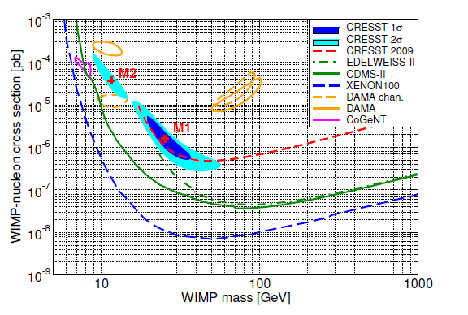
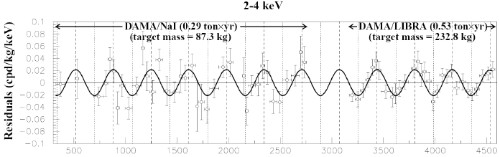
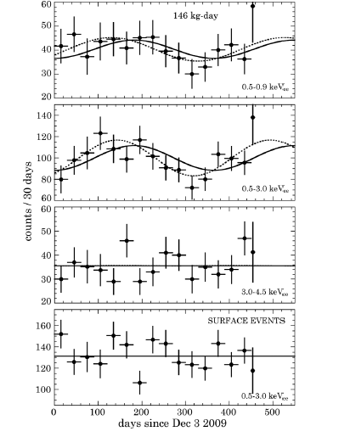
Status Cross Section Limit
DAMA/LIBRA [ NaI, 8.9σ annual modulation]
CoGent [Ge, 2.86σ Ann. Mod.]
Notes:
dark matter discovery cant be concluded

Slide 9
Directional Dark Matter Search with Nuclear Emulsion
WIMP wind
Nuclear emulsion
WIMP wind
WIMP
e-
cf. Gaseous Detector
(All other directional DM search experiments use gaseous detector .
e.g. gaseous TPC, MWPC )
Diffusion
⇒ problem of size limit
Ionized electrons closed in the crystal
⇒ diffusion problems are nothing .
if extreme short tracks is detectable,
Large mass experiment is relative easy
readout

Slide 10
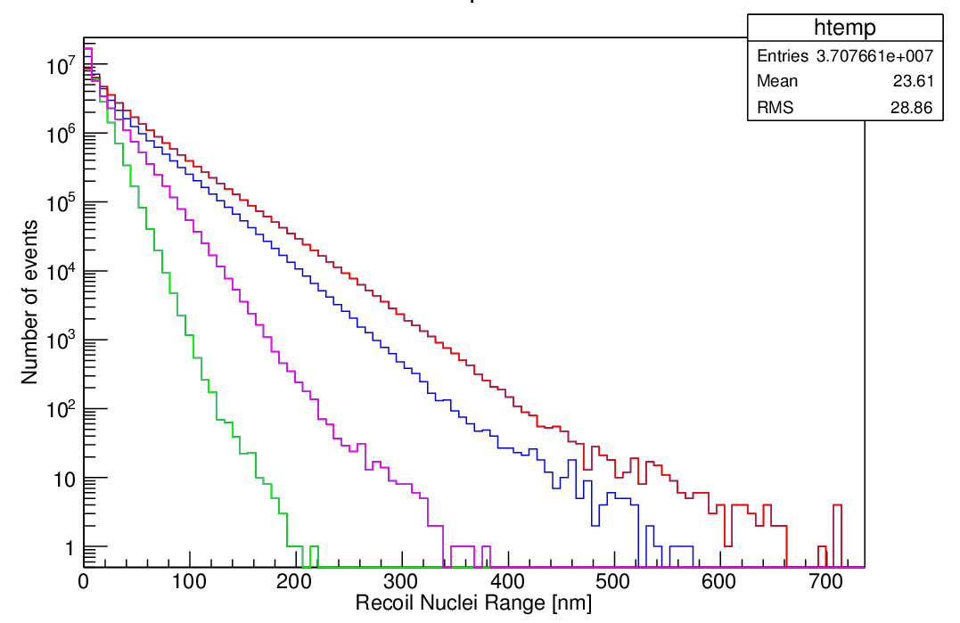
Expected Range of Signal Tracks
Expected track length from WIMP recoil
― : 100 GeV/c²
― : 50 GeV/c²
― : 20 GeV/c²
― : 10 GeV/c²
10 GeV/c²
20 GeV/c²
50 GeV/c²
100 GeV/c²
Track length [nm]
The ranges of our target tracks are only several 100 nm

Slide 11
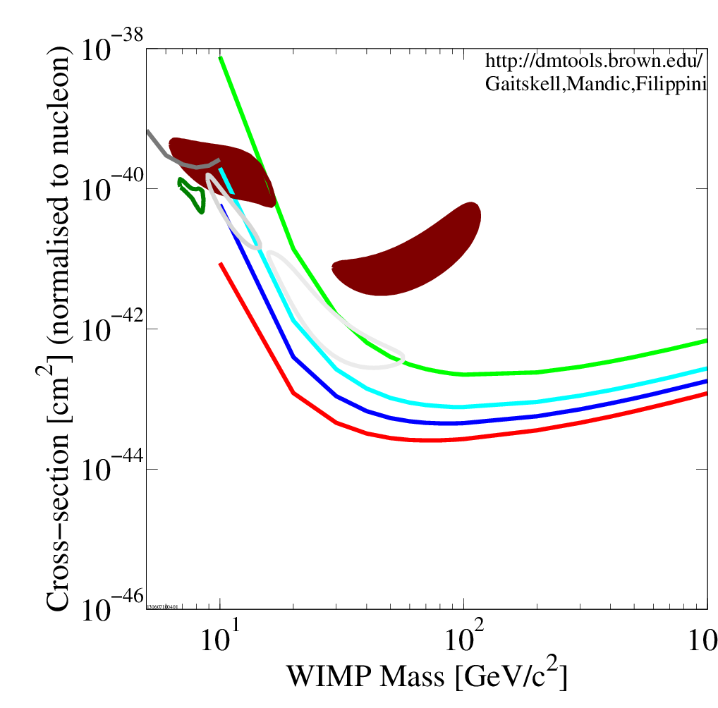

Ideal Cross Section Simulation
[spin independent, 25kg・y, 90% C.L.]
R>200 nm
R>150 nm
R>125 nm
R>100 nm
Preliminary
100 nm threshold allows
to cover DAMA region !

Slide 12
Index
Dark Matter
  About dark matter
  Dark matter search experiments
Emulsion R&D
  New production method
  Sensitivity control
Readout R&D
  Optical microscope
  X-ray microscope
Activity
Notes:
Then I show how we realize such experiments.
First section is detector improvement.

Slide 13
How we detect short tracks?
existing emulsion
(ex. OPERA emulsion)
fine grain emulsion
~ several 100 nm
Recoil Atom
Recoil Atom
200nm
200nm
Micronization of crystals is the key to detect short tracks
13
Notes:
so we tried to develop such fine grain emulsion

Slide 14
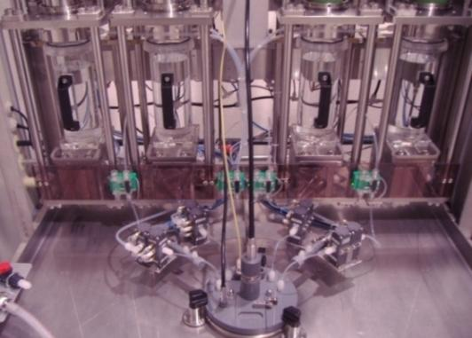
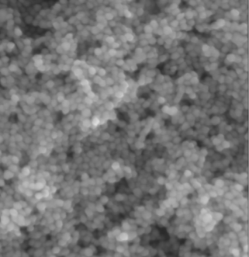
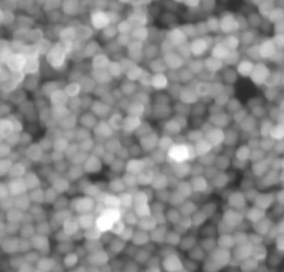
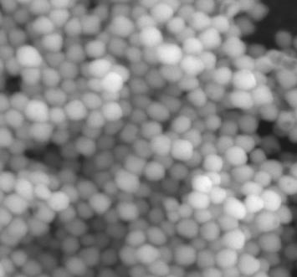
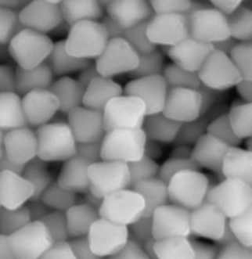
Production of Emulsion in Nagoya (2010~)
Production term: 4h
Scale: 100g/batch (dry condition)
We are planning new machine of the tripled volume (2013-14).
→20kg/month
~100kg experiment is possible
cooperation of Fuji Film OB
for machine and production
35nm crystal
70nm crystal
100nm crystal
200nm crystal
SEM Image
without Gelatin
For dark matter
500nm
Notes:
Thanks to this machine, and cooperation of Fuji Film OBs, we can do very flexible study.
This machine can produce many type emulsion, and that fine crystal type is used for our experiment.
And then we are planning next machine which volume scale is 3 times of this one.
We can do 100kg scale experiments in maximum.

Slide 15
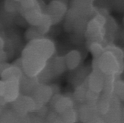
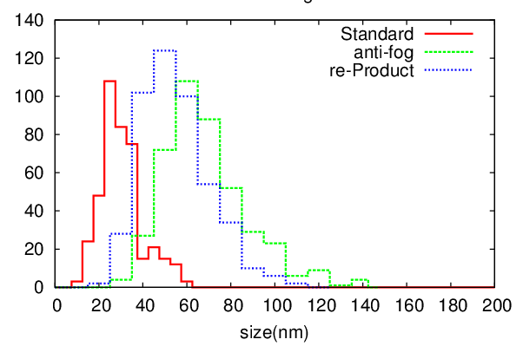
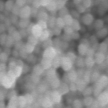
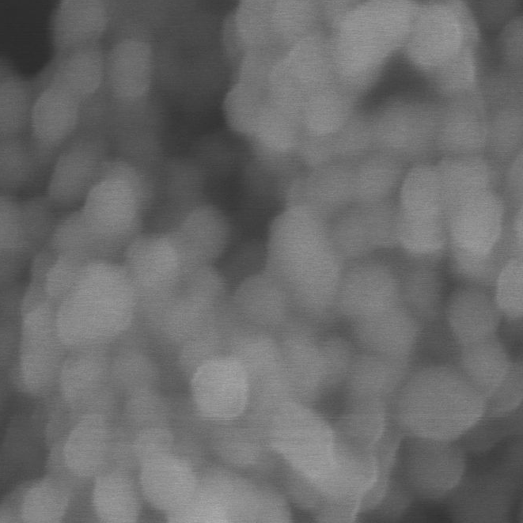
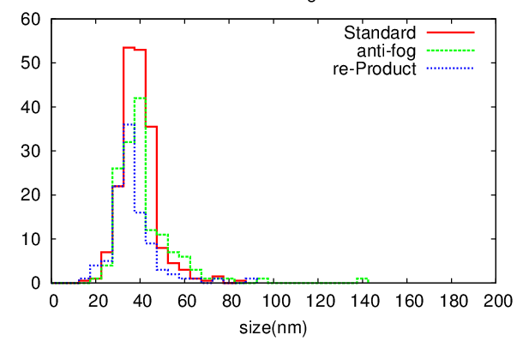
New production method for micronization
flocculate
ex-method
Some process
(ex. washing, sensitizing)
Initial crystal size
100μm
new-method
100μm
New producing method with polymer
Polymer strongly covers crystals surface, and disturbs their flocculate
100μm
Notes:
フロキュレート

Slide 16

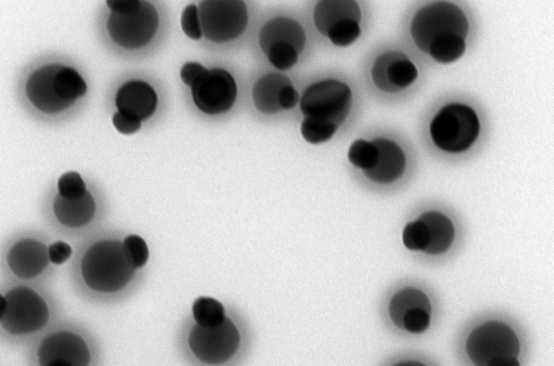
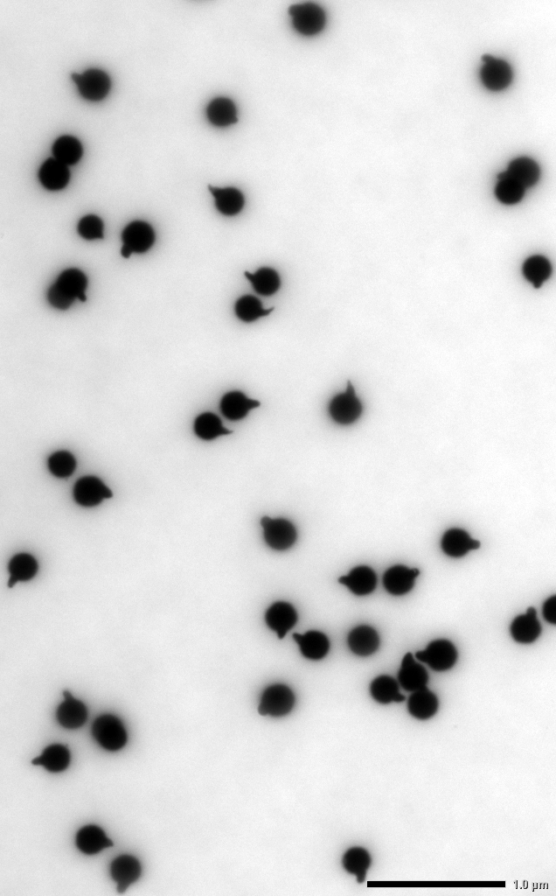
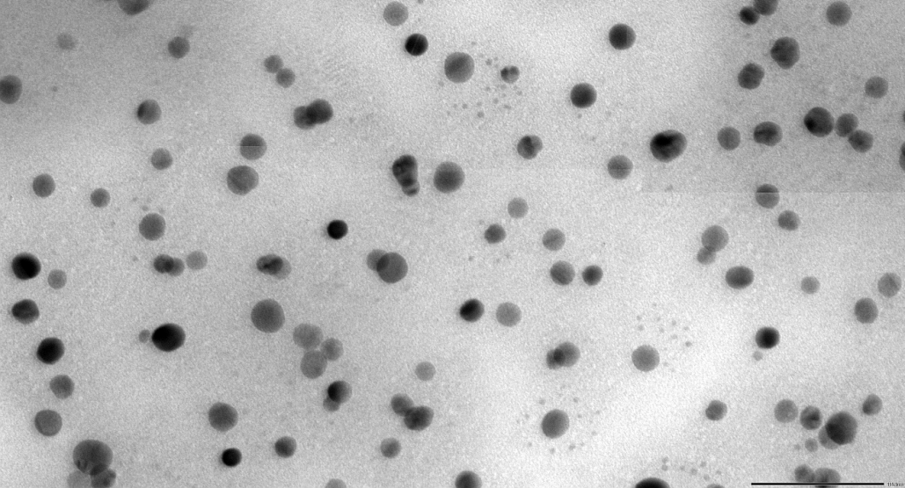
Produced emulsions
NIT type
~45 nm
OPERA type
~200nm
100 nm
100 nm
U-NIT type
~18 nm
100 nm
1 μm

Slide 17
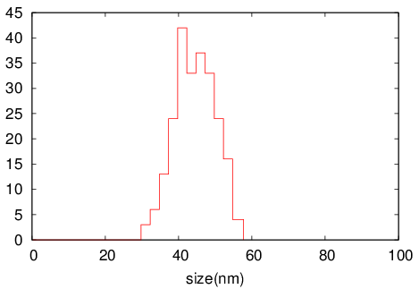
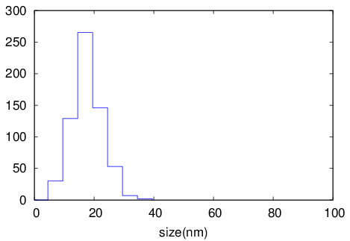
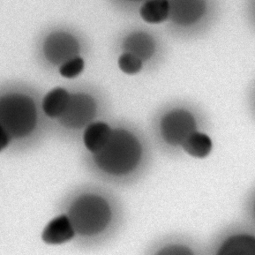

Current Fine-grain detector
NIT
U-NIT
Mean : 44.6 +- 0.4 [nm]
Sigma : 6.1 +- 0.3 [nm]
Mean : 18.0 +- 0.2 [nm]
Sigma : 4.9 +- 0.2 [nm]
100 nm
100 nm
Crystal diameter [nm]
Crystal diameter [nm]
current main R&D for test run
Finest grain emulsion for physics run
 | NIT | U-NIT
crystal density | 12 crystal/µm | 29 crystal/µm
Detectable range | > 200 nm @ C | > 100 nm @ C
Tracking E threshold | > 80 keV @ C | > 35-40 keV @ C
Reproducibility of them is good
Size is stable while 3.0-3.7 g/cm³

Slide 18
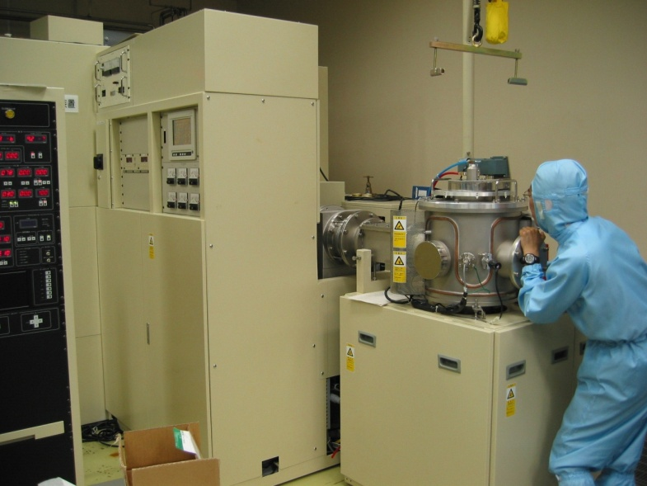
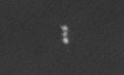
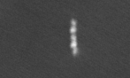
Short Track sensitivity
implanted ions on emulsion surface
Ion implantation machine
Low energy ion is same to recoil signals
Kr 200keV
200nm
preliminary
Tracking efficiency of NIT :
175keV (520nm expected): 80%
80keV (250nm expected) : 50%
→each crystal sensitivity : 50%?
U-NIT sensitivity is quite low
Our next task is Sensitizing
Kr 400keV
500nm
Scanning Electron Microscope

Slide 19
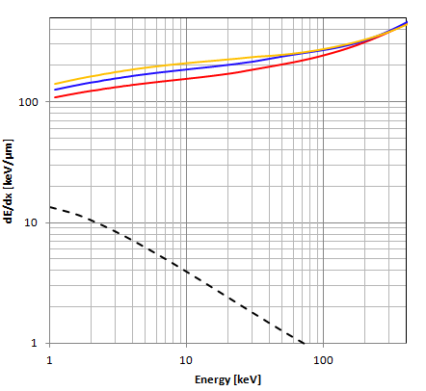
sensitivity control
dE/dx vs. energy
Main background :
intrinsic radio isotope
(e.g. C-14, Th・U families etc.)
→ γ・β backgrounds
Target nuclei to DM : C, N, O
→ Total dE/dx > ~100 keV/µm
O
N
C
sensitive
insensitive
electron
To make high contrast threshold of dE/dx
e.g.
doping impurities to capture electron / hole
adding pigments or chemicals on surface
for sensitizing and anti-fog
upgrade of developing method for
sensitivity control and to develop fine grains
(for resolution)
→now studying
dE/dx difference will appear as the number of exited electron and the size of latent image speck
Notes:
イントリンジンク
high contrast

Slide 20
Index
Dark Matter
  About dark matter
  Dark matter search experiments
Emulsion R&D
  New production method
  Sensitivity control
Readout R&D
  Optical microscope
  X-ray microscope
Activity

Slide 21
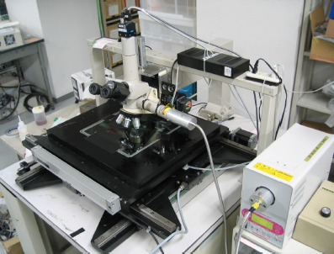
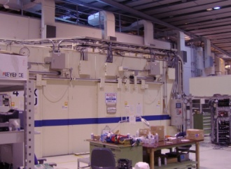
Readout Concept
Optical microscope
candidate selection
fast & automatic 3D selection
ellipse-fitting for candidates
⊿x ~ 250 nm
X-ray microscope
signal confirmation
non-destructive & high resolution
observing grains one by one
⊿x < 70nm

Slide 22
Readout Concept
Optical microscope
candidate selection
fast & automatic 3D selection
ellipse-fitting for candidates
⊿x ~ 250 nm
X-ray microscope
signal confirmation
non-destructive & high resolution
observing grains one by one
⊿x < 70nm
Notes:
I introduce readout system with a certain test case.

Slide 23
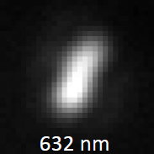
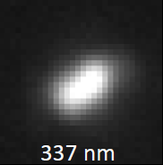
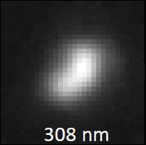
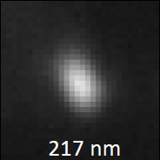
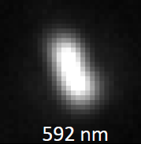
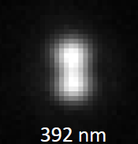
Demonstration using heavy nuclei recoil tracks induced by 14MeV neutron (D-T reaction)
Mostly Br recoil (170 - 600 keV), because of low sensitivity tuning
Optical image (Epi-illuminated)
Notes:
We used nuclei recoil tracks induced by 14 MeV neutron by D-T reaction for the development of readout system.
These are the actual images of recoil tracks, and mostly Br recoil, because of low sensitivity turning.

Slide 24
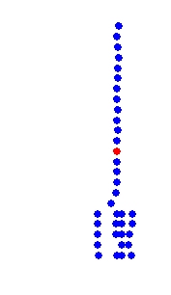
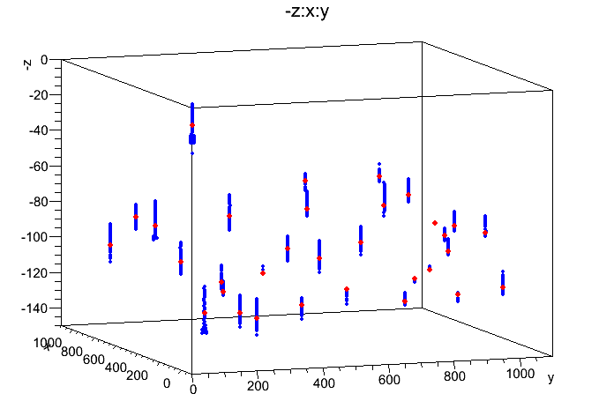
Automatic Candidate Selection
Fitting as ellipse
Best focus selection
Original image
1 view
1 um
Focus direction
1.7µm
Ellipse fit
Major
Ellipse fit
Red : best focus layer
Blue : defocus layer
Candidate events are automatically detected
mainly with Ellipticity.
-3D position information
-Brightness, Shape, Area
-Angle etc.
Minor
Notes:
Fit to elipse
best focus selection to reject out focus
Finally we can get the exact position of candidate, and many parameters.

Slide 25
Readout Concept
Optical microscope
candidate selection
fast & automatic 3D selection
ellipse-fitting for candidates
⊿x ~ 250 nm
X-ray microscope
signal confirmation
non-destructive & high resolution
observing grains one by one
⊿x < 70nm

Slide 26
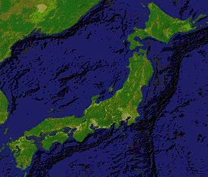
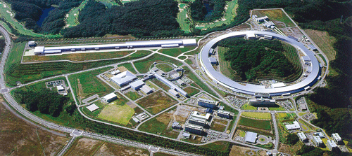
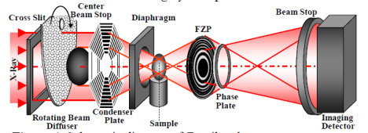
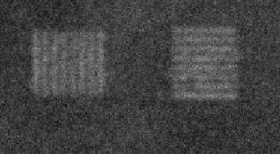
Confirmation by X-ray microscope
SPring-8 @ Japan
-Thickness of film : 100µm
-Focal depth : 70µm
-Type of optics: phase contrast
-X-ray Energy : 8keV
8keV X-ray
Zone plate
Zernike phase plate
System is almost ready
for realistic dark matter search.
70nm lines&70nm spaces
(theoretical resolution = 62 nm)
Notes:
Super Photon ring-8 GeV
The world largest synchrotron radiation facility

Slide 27
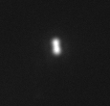







Tracks Matching between Optical and X-ray Micro Scope
Optical
X-ray
236nm
330nm
486nm
600nm
Matching efficiency ：572 / 579 event = 99%
the shift from predicted position
(Optical→Xray) : < 5µm
7800 event / day
recoil tracks 14 MeV neutron (D-T nuclear fission)
Notes:
candidates selected from optical micro scope
elliptical image of candidates become tracks.

Slide 28




Signal selection efficiency with optical microscope
major : Y
signal region
optical angle
neutron
θ
recoil
minor : X
major(pixel)
2D Angle(rad)
optical readout efficiency
・track
・noise
efficiency
minor (pixel)
X-ray info
The efficiency of optical microscope
is measured with comparing both optical and X-ray event data.
track angle is well measured by optical.
We can select signals longer than 200 nm.
(Preliminary)
preliminary
Notes:
This is check of efficiency with signal selection with optical microscope
This is events plot using Ellipticity with optical microscope.
Horizontal axis is Minor, and vartical axis is Major length of Ellipse.
クリック
With X-ray information, we can reject noise.
クリック
With this results, we can draw a cut line here.
クリック
These signals indicate the incidence direction of neutron
And bottom figure is the optical readout efficiency of this black cut line.
クリック
We can detect tracks until 200nm visible length by using optical microscope.
Like these, fundermental readout system is established.

Slide 29



Study for upgrade
Read out speed up
  now : 0.1g/day → 10~100g scale
Optics upgrade
  objective lens and wavelength
Plasmon analysis
  Selection of dE/dx from scattering light
Fluorescence analysis
  Super resolution;~50 nm is expected !
Notes:
2. simulation shows that it changes dull ellipse to sharp ellipse
フルレッセンス

Slide 30
Index
Dark Matter
  About dark matter
  Dark matter search experiments
Emulsion R&D
  New production method
  Sensitivity control
Readout R&D
  Optical microscope
  X-ray microscope
Activity

Slide 31
Near Future Plan
2013
2014
2015
2016
study in Lab
developing sensitivity
new readout methods
crystal sensitivity control
understanding for BG
1g scale test run
at LNGS
BG insensitive crystal
readout BG rejection
high sensitive U-NIT
high speed system
10-100 g scale
physics run.1
equatorial telescope
kg scale run for DAMA region

Slide 32





R&D underground facility in Gran Sasso
Gran Sasso (LNGS), Italy
2nd Floor: Detector Production
1st Floor : Development Facility

Slide 33
Collaborator and Technical Supporter
Nagoya University
T. Naka (Organizer of Japan and all)
T. Asada ( R&D of fine-grained emulsion )
T. Katsuragawa ( Readout system)
M. Yoshimoto (Optical Readout Stage)
K. Hakamata (Development treatment)
M. Ishikawa (Plasmon analysis study)
K. Kuwabara (R&D of emulsion)
A. Umemoto (Plasmon analysis)
S. Furuya (detector R&D)
S. Machii (optical microscpe )
Nagoya University [ X-ray Astronomy]
Y. Tawara (X-ray microscope)
University of Napoli
G. de Lellis (Organizer of Europe)
A. Di Crescenzo (DM simulation)
A. Sheshukov (Emulsion simulation)
A. Aleksandrov (Optical stage study)
V. Tioukov (tracking algorithm)
University of Padova
C. Sirignano ( LNGS activity)
LNGS
N. D’Ambrossio
(Optical microscope study in LNGS)
N. Di Marco (simulation, background)
F. Pupilli (background measurement)
Chiba University
K. Kuge (emulsion and development study)
Fuji Film researcher
T. Tani (Emulsion and phenomenology)
K. Ozeki (Emulsion and phenomenology)
S. Takada (the emulsion sensitivity)
SPring8
Y. Suzuki, A. Takeuchi, K. Uesugi and Y. Terada

Slide 34


1st DM collaboration meeting @ LNGS
participants
Nagoya, Napoli, LNGS, Padova, Dubuna, Moscow
Sensitivity simulation
Intrinsic backgrounds
neutron study
R&D of emulsion and development
Readout technology
2nd meeting will be held
on November 2013
If you become interesting in our study, Let’s join the meeting .

Slide 35
Summary
We try to survey WIMP wind direction with nuclear emulsion.
We succeeded to make stable fine grain.
  current challenge : sensitivity control
Fundamental readout method is demonstrated.
  current challenge : higher resolution readout method
We plan to do gram scale test run soon
and < 100 g physics run within several years.
Notes:
Thank you for your kind attention.

