Slide 1
Bucharest emulsion group along the time
Who we are

Slide 2
Milla Baldo Ceolin THE DISCREET CHARM OF THE NUCLEAR EMULSION ERA

Slide 4
1956 Institute of Atomic Physics
Laboratory of cosmic rays
1958

Slide 5
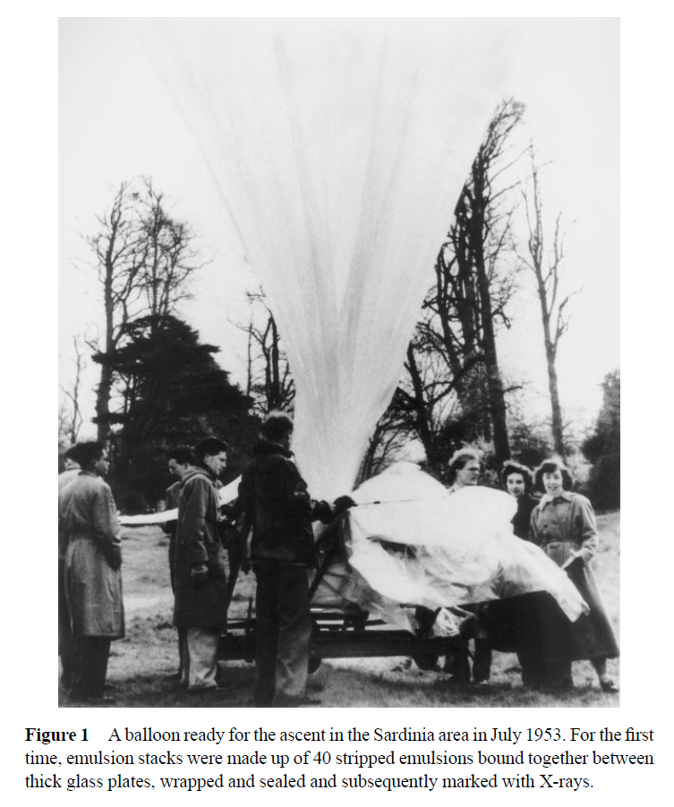

Slide 9
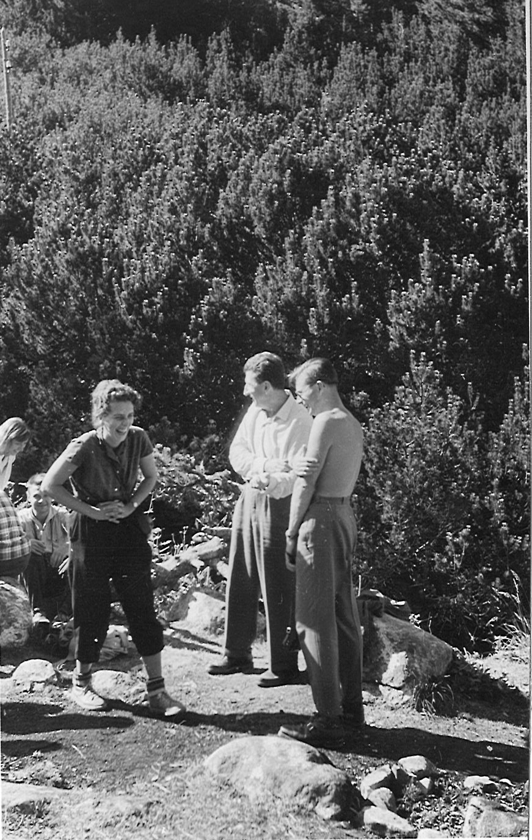
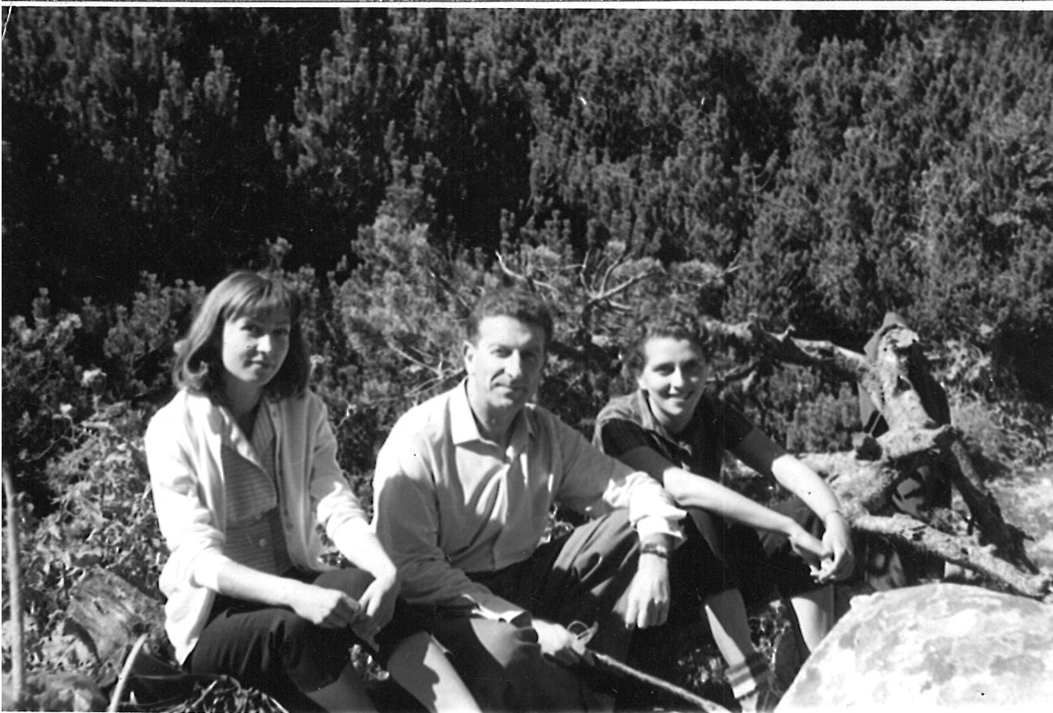
Poza cu Feinberg

Slide 10
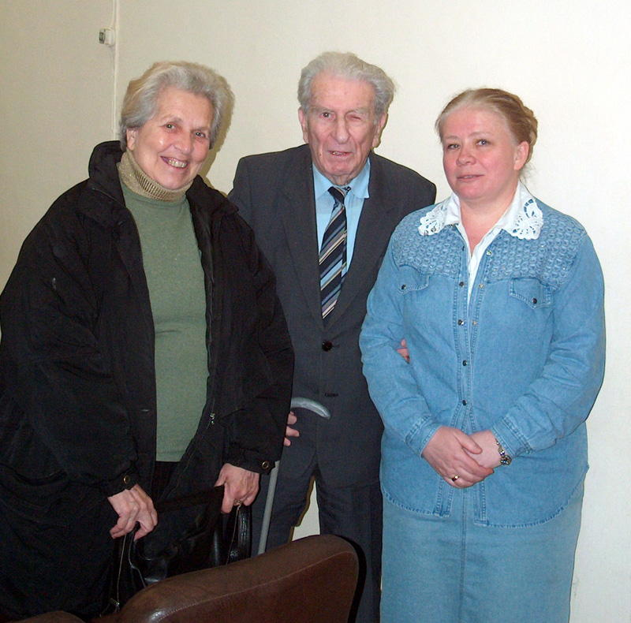

Slide 11
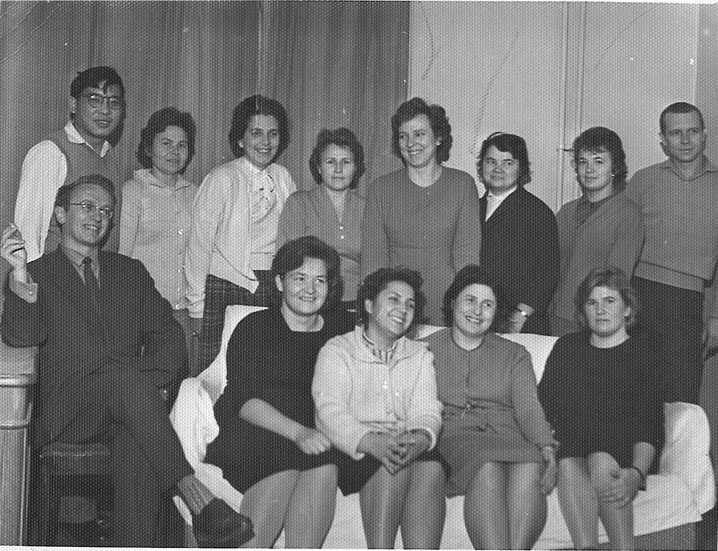

Slide 12
CERN - ISR a particle accelerator , the first hadron collider, and run with a maximum center of mass energy of 62 GeV
1972 - The ratio of the production of very slow antiprotons to that of pions in the same momentum interval was measured at the ISR by means of nuclear emulsions. Averaged over the interval 0.12 GeV/c ⩽ p⊥ ⩽ 0.34 GeV/c and 0 ⩽ p∥ ⩽ 0.2 GeV/c, .

Slide 13
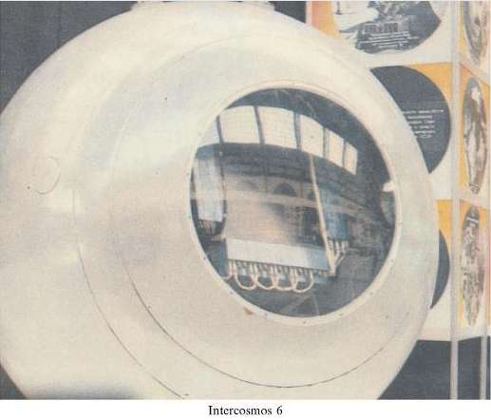
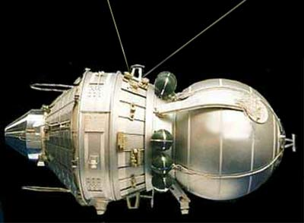

Slide 14
1, 4 track spark chambers
2 emulsion stack
3 horizontal emulsion sheets
5, 7 scintillators
6 Ionization calorimeter
8 PM
We scanned for mini electron positron showers and traced them back until we fond their origin - the interaction of nuclei. In five events selected for analysis, as a result of 67 interaction, we determined the mean multiplicity 3.3+-0.7. The energy of the primaries was eveluated as above 1 TeV.

Slide 17
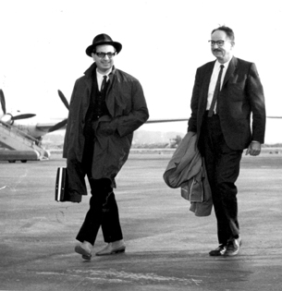

Slide 18
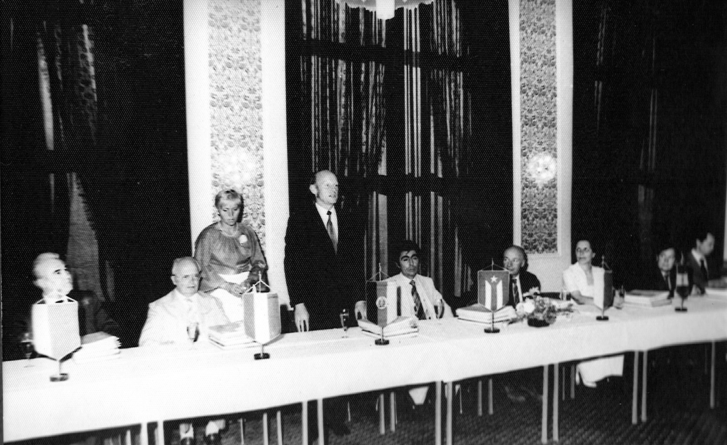
Intercosmos

Slide 19
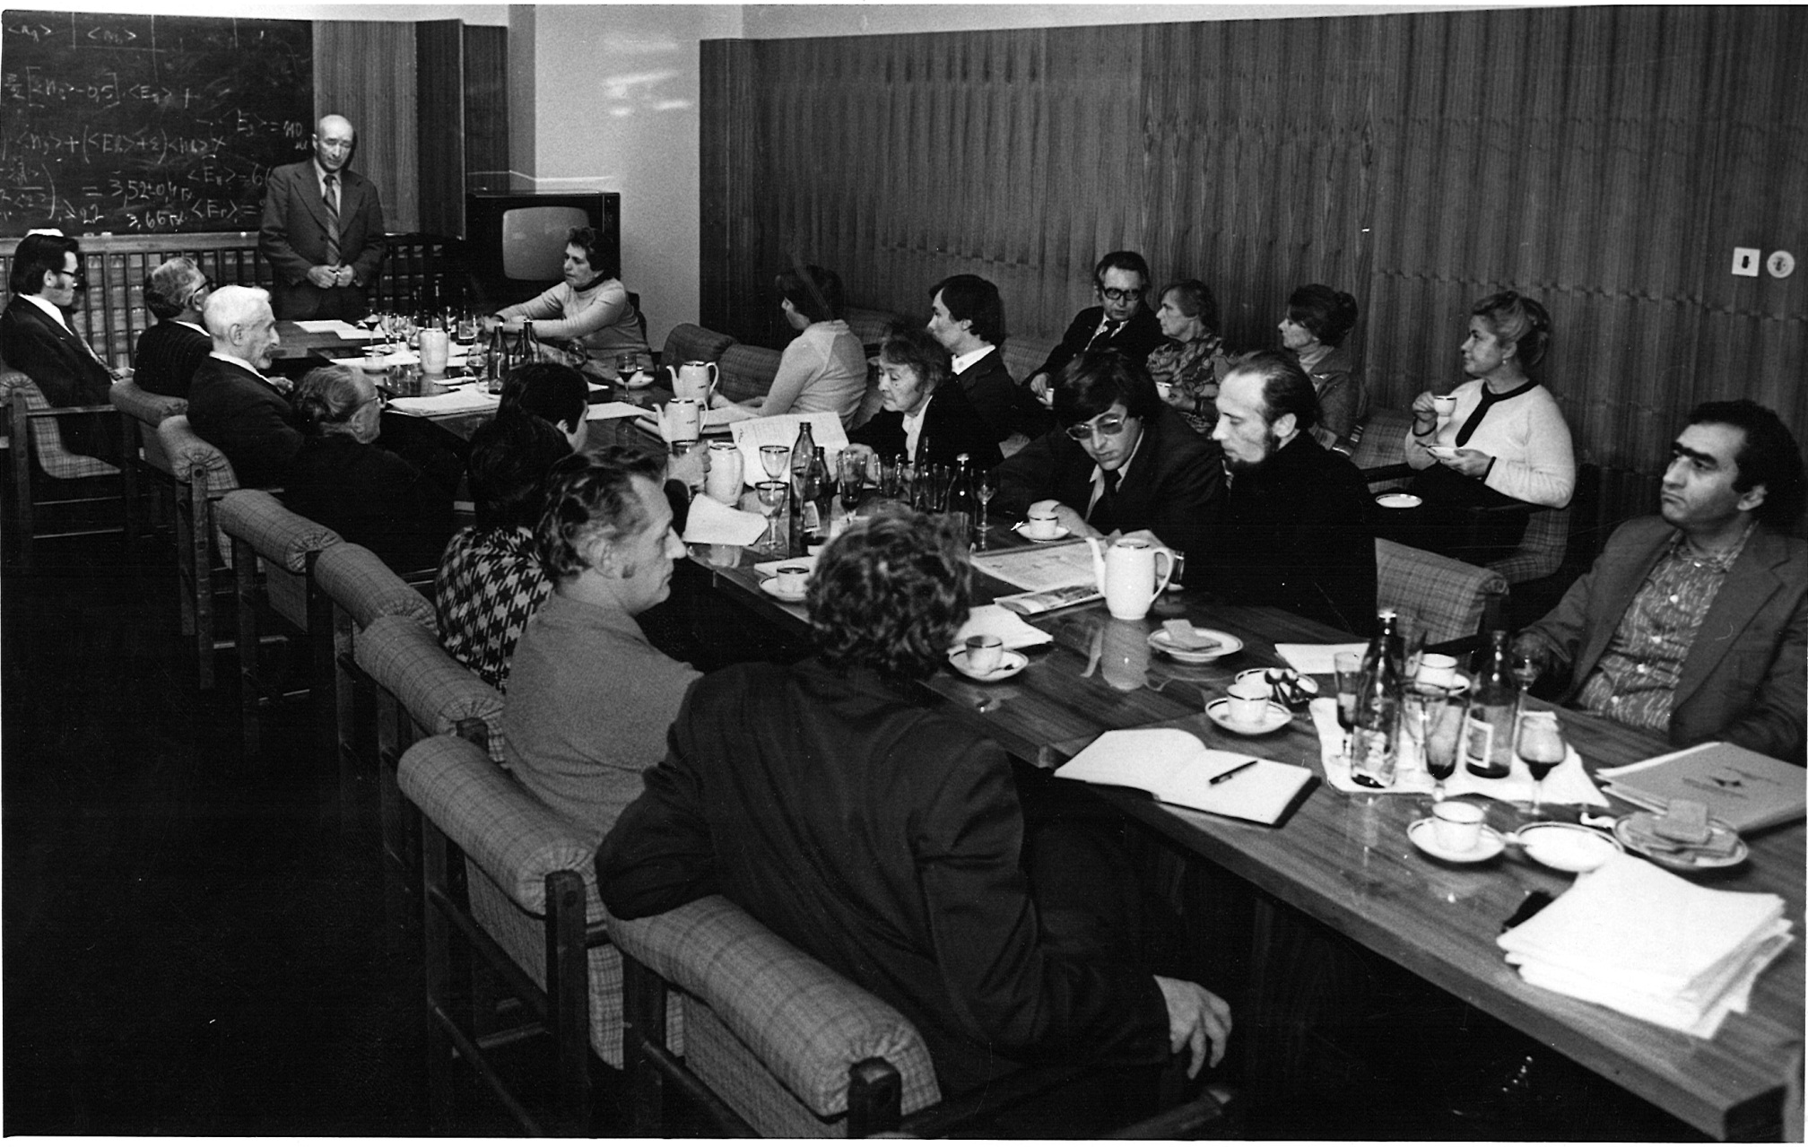

Slide 20
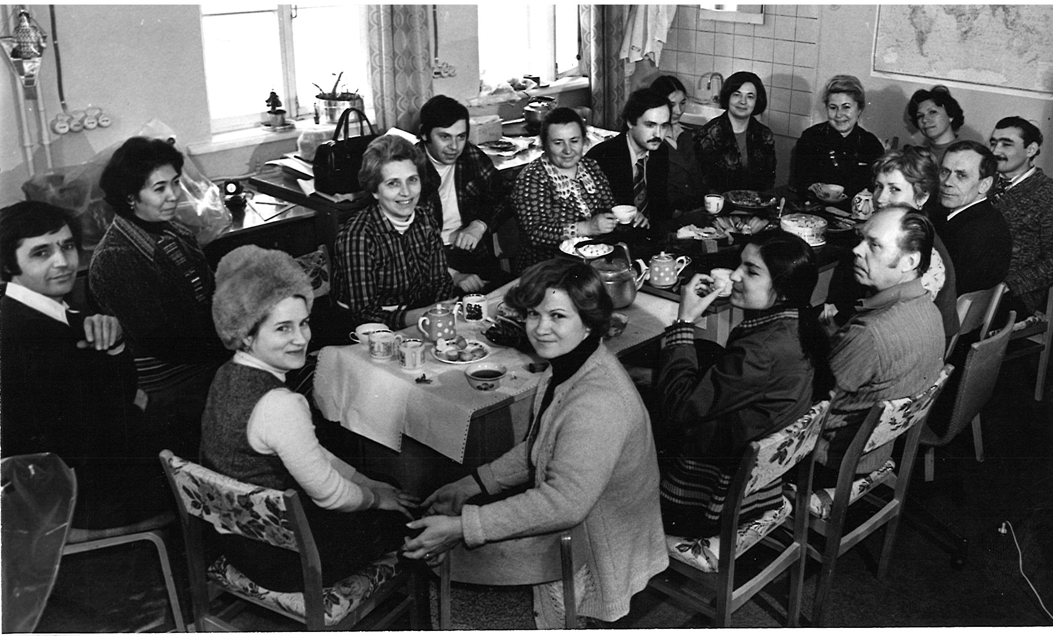

Slide 21
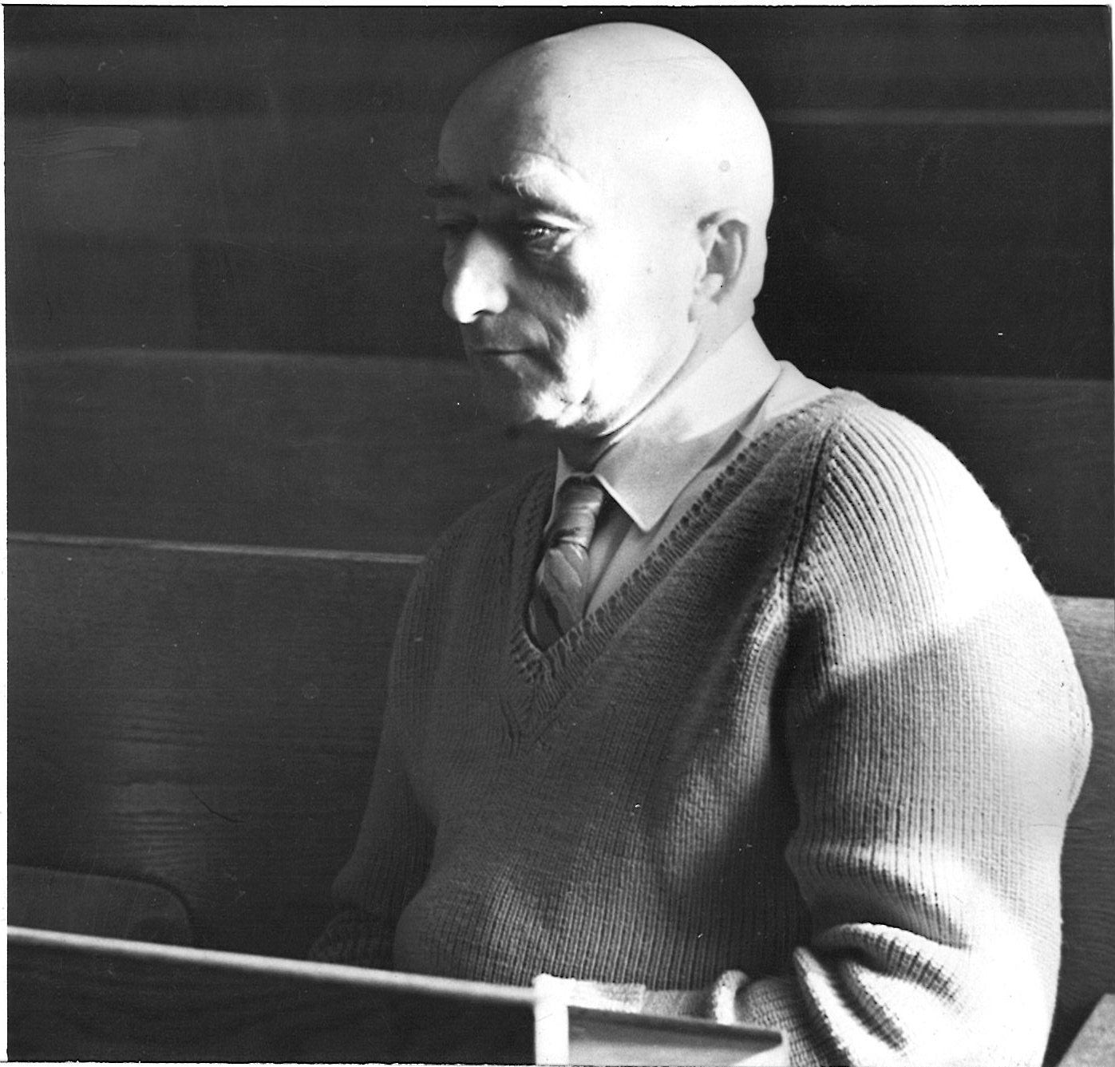

Slide 22
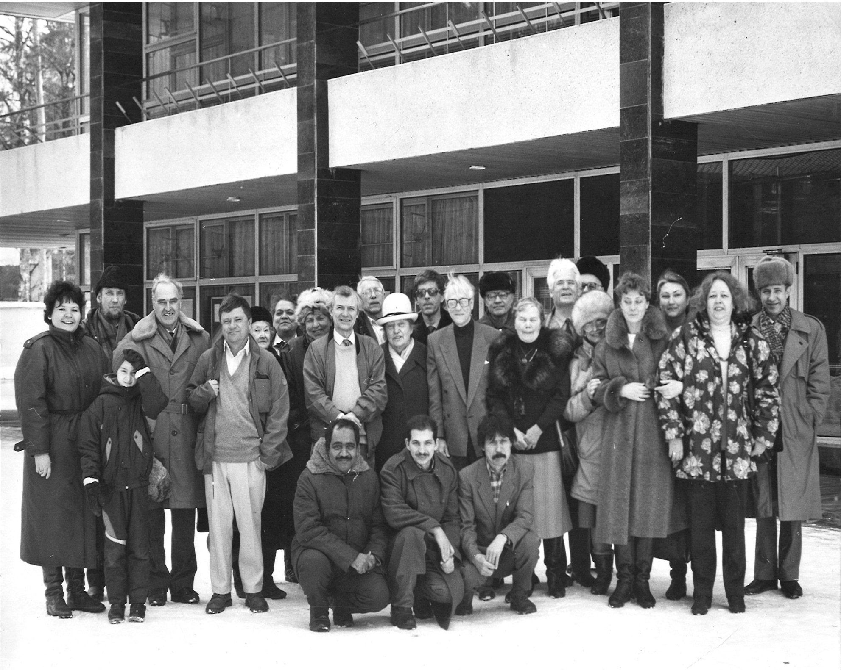

Slide 24
Production of Slow Particles in High Energy Heavy Ion Collisions
Helium Production in 158A GeV/c Pb on Pb Interactions
Helium Production in 10.7A GeV/c Au induced Nucleus-Nucleus Collisions
Produced Particle Multiplicity Dependence on Centrality in Nucleus-Nucleus Collisions
Complex Analysis of Au Interactions with Photo-Emulsion Nuclei at 10.7 GeV/nucleon within the framework of Cascade and Fritiof models
Multifragmentation of Au Nuclei at 10.7 GeV/nucleon
Nuclear Effect in Higher Dimensional Factorial Moment Analysis of 16O-, 32S-, & 197Au-Em interaction data at 200, 60 and 11GeV/c
Critical Behaviour in Au Fragmentation at 10.7A GeV/c
Charged Particle Multiplicity Density and Fluctuations in Pb on Pb Interactions at 158A GeV/c
Bounce-off in 197Au Induced Collisions with Ag(Br) Nuclei at 116 A GeV/c
Fragmentation and Multifragmentation of 10.6 A GeV Gold Nuclei

Slide 25
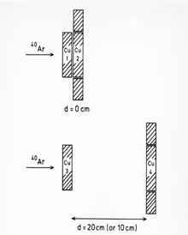

Slide 26
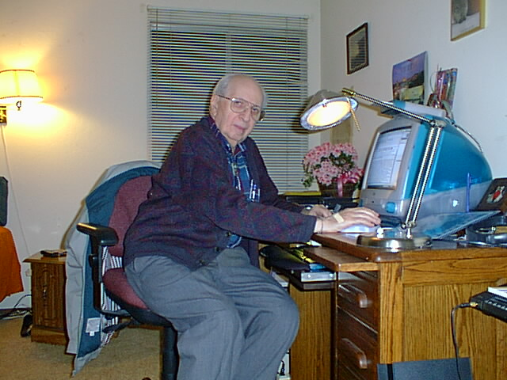

Slide 27
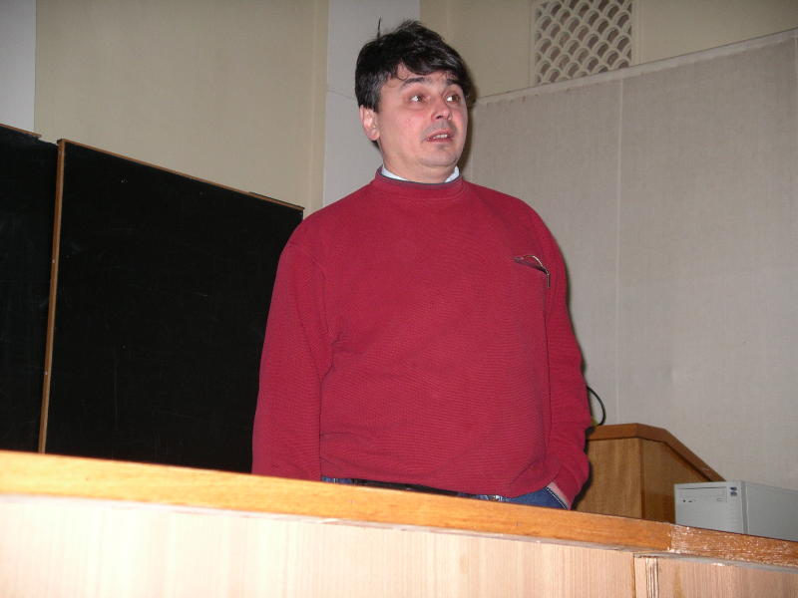

Slide 28
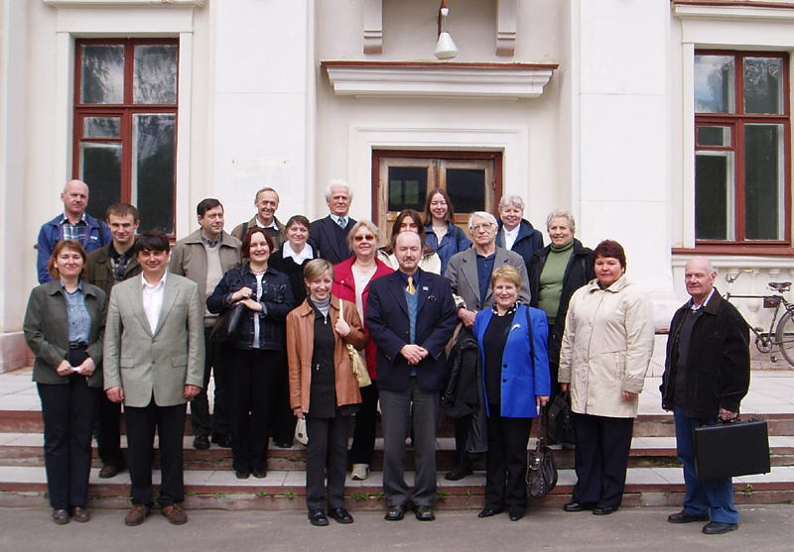

Slide 29
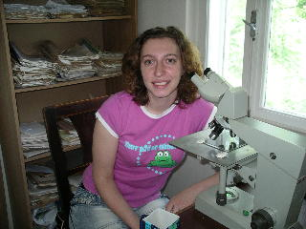
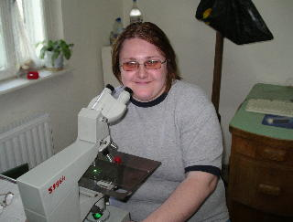
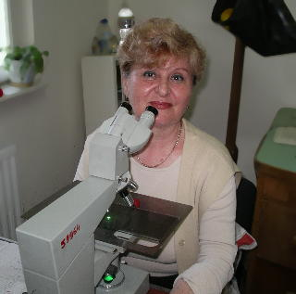
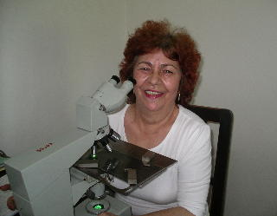

Slide 30
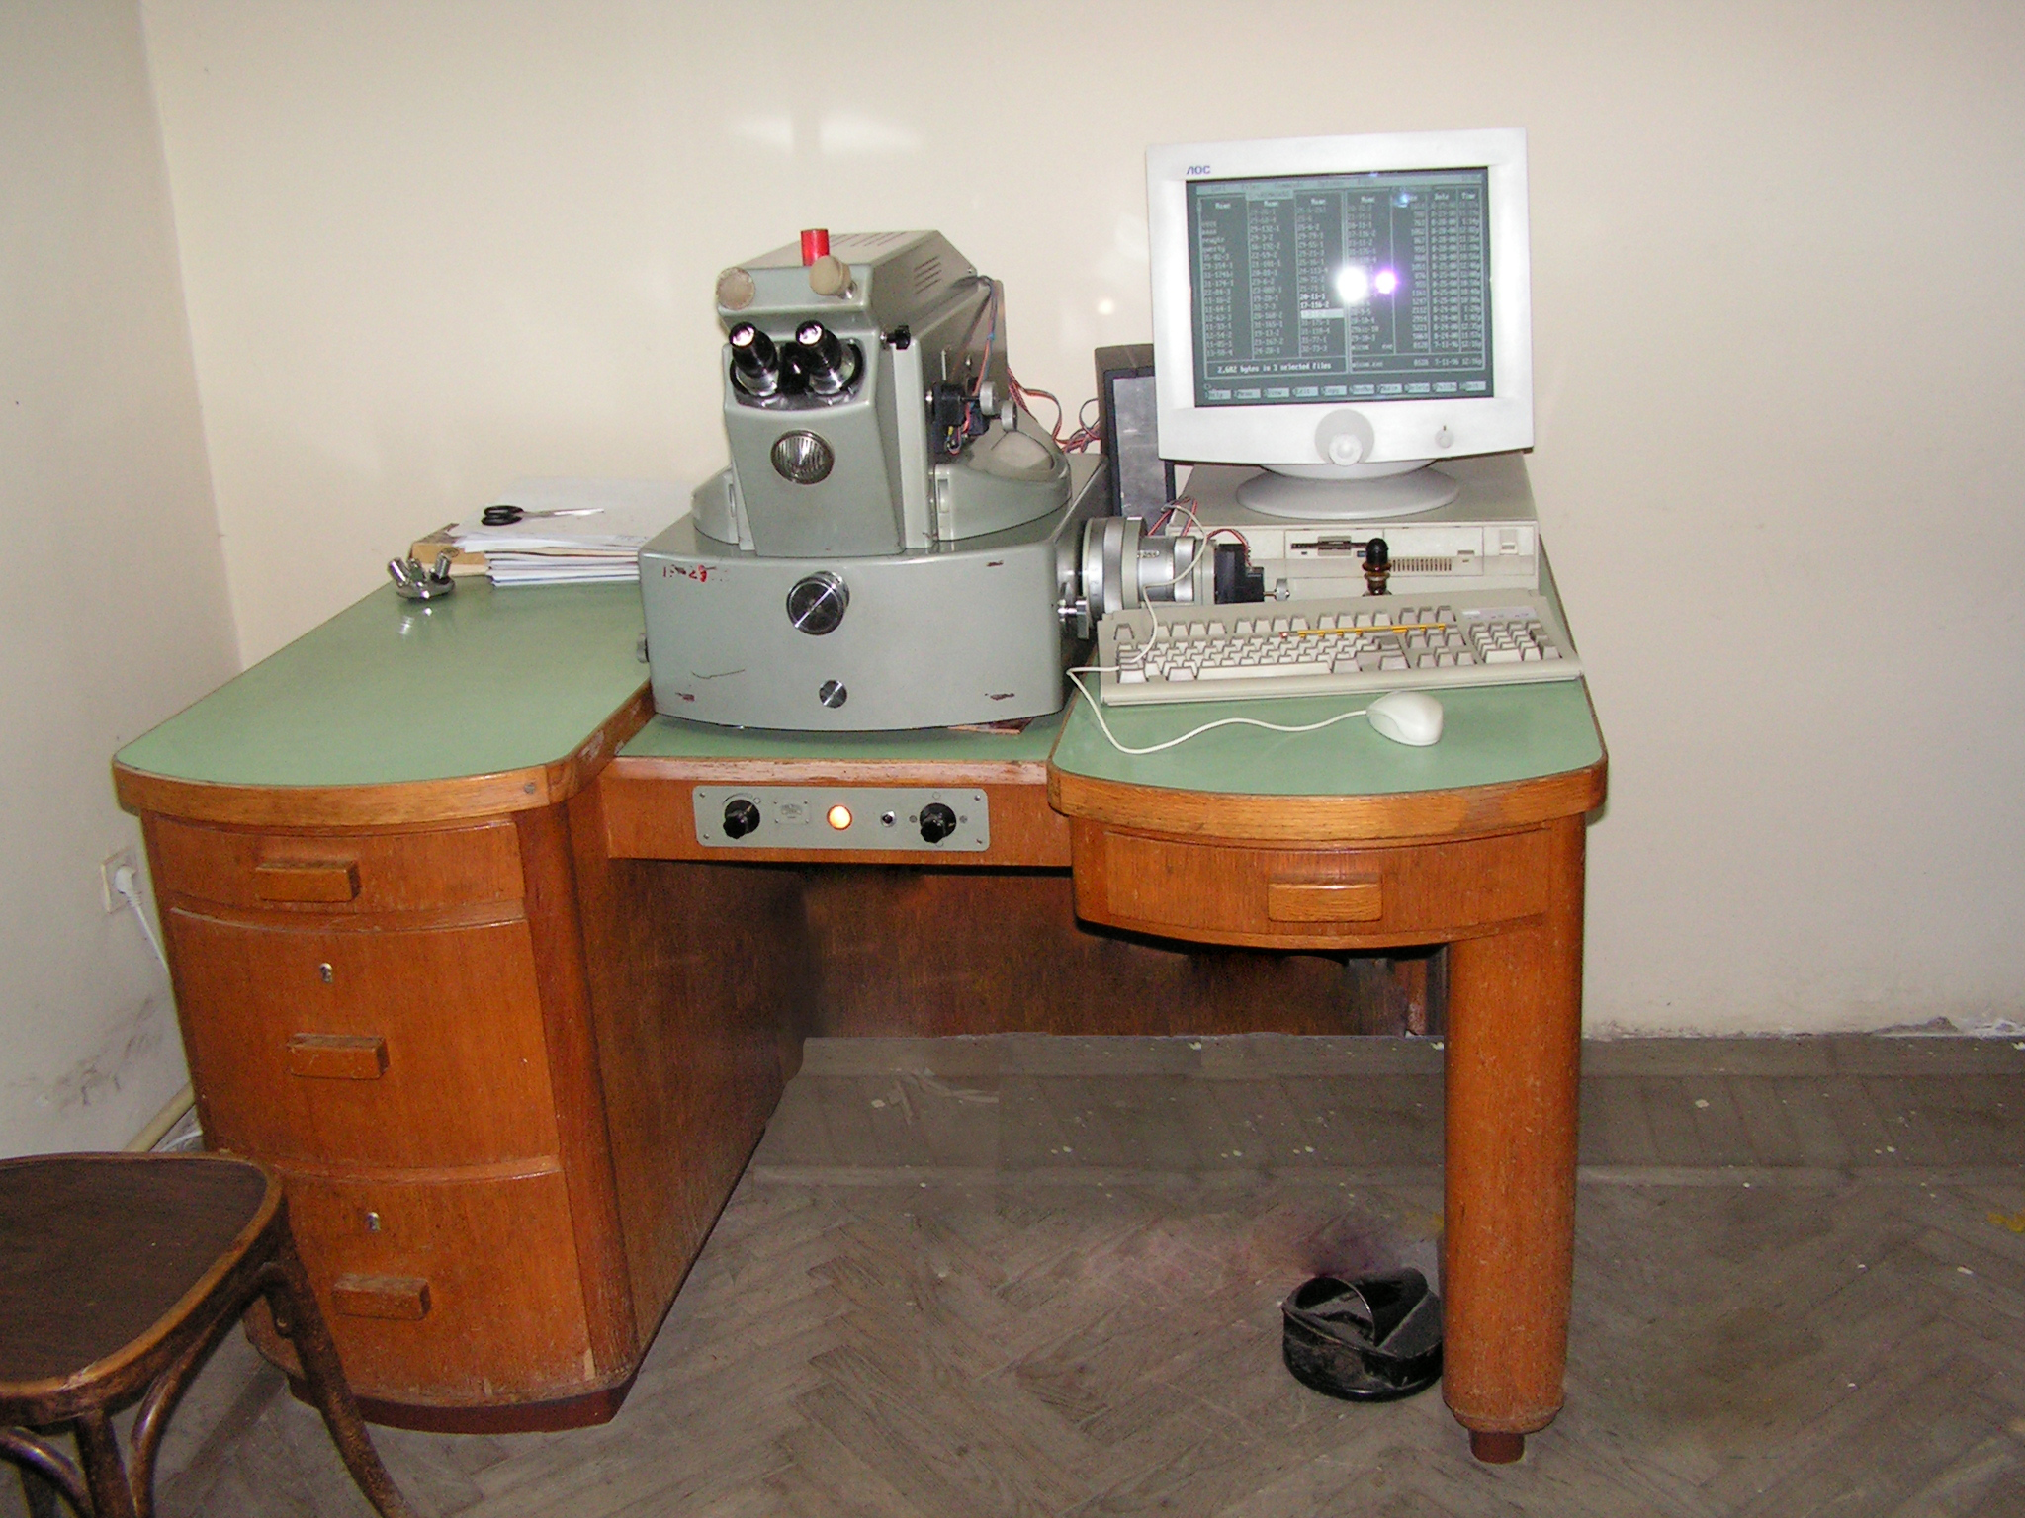

Slide 31
